Slide 1
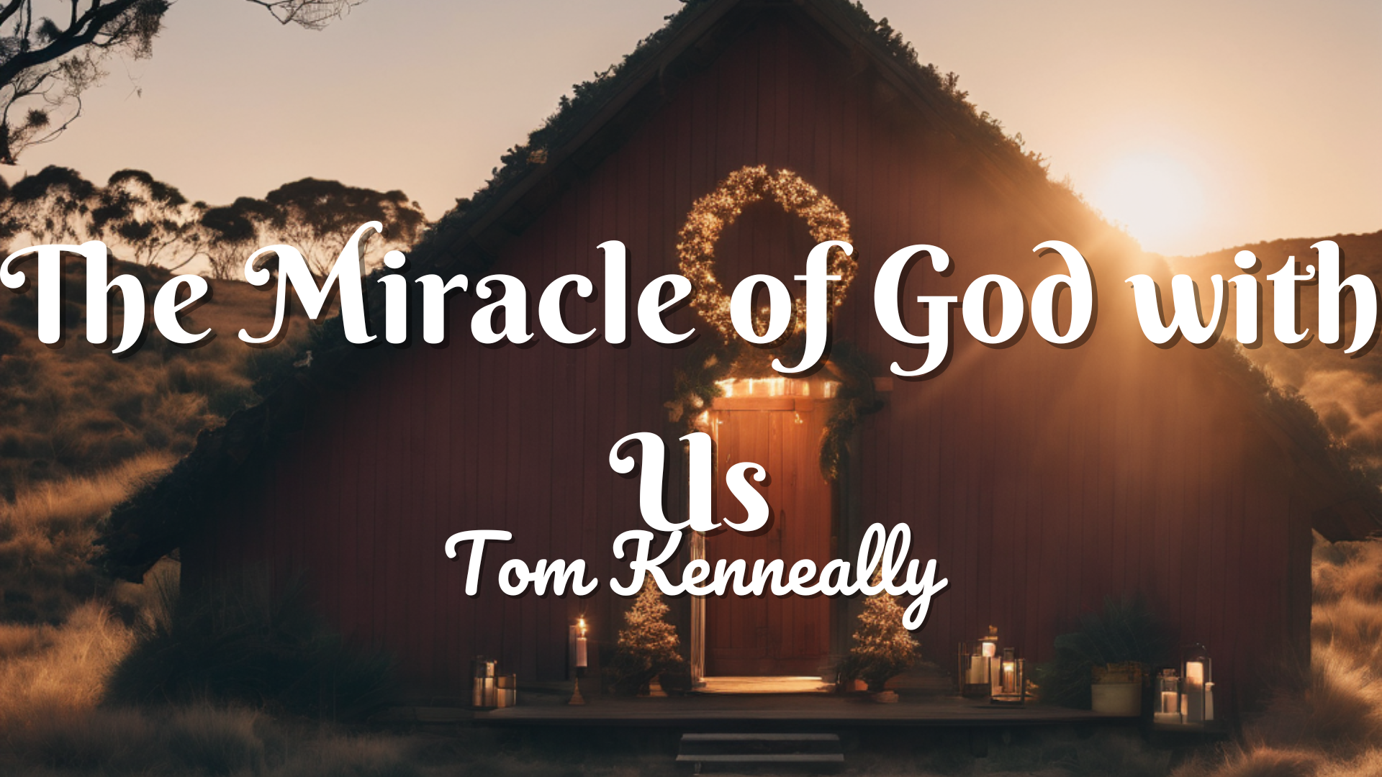

Slide 2
A Celebration beyond Compare
In person – we are making party hats or birthday card in anticipation of the celebration
Online – we are making a birthday card with folded paper, draw or write a message to God express excitement over the good things of God.

Slide 3
Significance of Celebration
Ecclesiates 3:4 – “ a time to weep and a time to laugh, a time to mourn and a time to dance”
Express Joy!

Slide 4
Childlike anticipation
We are to be like a child in the simple trust that a child often has for the things that its parent promises
Matthew 18:3

Slide 5
Preparing our hearts
We are called to be intentional with everything, including worship.
We must prepare our hearts so that can give a personal offering to a personal God.

Slide 6
A Celebration beyond Compare
In person – we are making party hats or birthday card in anticipation of the celebration
Online – we are making a birthday card with folded paper, draw or write a message to God express excitement over the good things of God.

Slide 7
The Gift
In person – we are creating gifts, coasters or wooden trinkets.
Online – we are going to do origami, we will show you and leave a slide on how to do it with a bit of paper.

Slide 8
The Gift Beyond Measure
The Gift of Jesus: Ephesians 2:8-9
“For it is by GRACE you have been saved, through faith – and this is not from yourselves, it is a gift from God – Not by works, so that no one can boast”

Slide 9

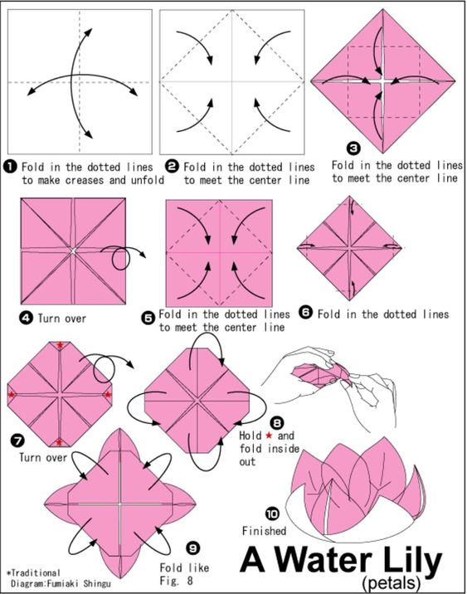

Slide 10
Sweetness of God’s Goodness
In person – we are making cakes
Online – Please find a sweet or nice treat, enjoy it and reflect on the Sweetness of God’s Goodness

Slide 11
Mirroring and Intentionality
In the act of creating we mirror the greatest creator, we can use it to honour Him.
We have a choice, we are to be intentional with all those choices that God has now given us.

Slide 12
Share the Sweetness
Matthew 5:16
"In the same way, let your light shine before others, that they may see your good deeds and glorify your Father in heaven."

Slide 13
Luke 2:1-20
2 In those days Caesar Augustus issued a decree that a census should be taken of the entire Roman world. 2 (This was the first census that took place while[a] Quirinius was governor of Syria.) 3 And everyone went to their own town to register.

Slide 14
Luke 2:1-20
4 So Joseph also went up from the town of Nazareth in Galilee to Judea, to Bethlehem the town of David, because he belonged to the house and line of David. 5 He went there to register with Mary, who was pledged to be married to him and was expecting a child. 6 While they were there, the time came for the baby to be born, 7 and she gave birth to her firstborn, a son. She wrapped him in cloths and placed him in a manger, because there was no guest room available for them.

Slide 15
Luke 2:1-20
8 And there were shepherds living out in the fields nearby, keeping watch over their flocks at night. 9 An angel of the Lord appeared to them, and the glory of the Lord shone around them, and they were terrified. 10 But the angel said to them, “Do not be afraid. I bring you good news that will cause great joy for all the people. 11 Today in the town of David a Savior has been born to you; he is the Messiah, the Lord. 12 This will be a sign to you: You will find a baby wrapped in cloths and lying in a manger.”

Slide 16
Luke 2:1-20
13 Suddenly a great company of the heavenly host appeared with the angel, praising God and saying,
14 “Glory to God in the highest heaven,
and on earth peace to those on whom his favor rests.”
15 When the angels had left them and gone into heaven, the shepherds said to one another, “Let’s go to Bethlehem and see this thing that has happened, which the Lord has told us about.”

Slide 17
Luke 2:1-20
16 So they hurried off and found Mary and Joseph, and the baby, who was lying in the manger. 17 When they had seen him, they spread the word concerning what had been told them about this child, 18 and all who heard it were amazed at what the shepherds said to them. 19 But Mary treasured up all these things and pondered them in her heart. 20 The shepherds returned, glorifying and praising God for all the things they had heard and seen, which were just as they had been told.

Slide 18
The gift of God - Jesus
Jesus is available to all, regardless of background or how you are right now.
We have all fallen short, everyone, and God chose to become Jesus so that He may save us and be with US forever.

Slide 19
Take a moment,
To either pray or finish off your activities in consideration of God’s goodness in sending His ultimate gift to you.
Are you or have you accepted it?

